Slide 1
Getting Data from the Web: Web APIs

Slide 2
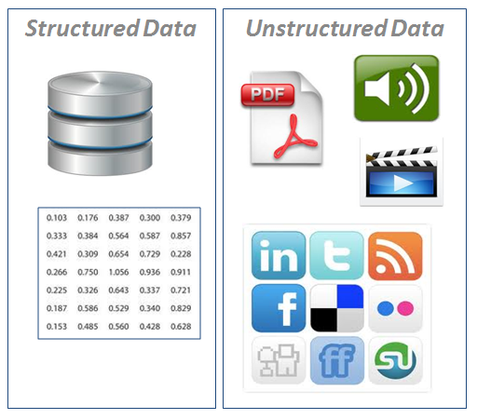
Preliminaries
Data can be divided into 2 big types:
Structured data refers to information with a high degree of organization such as for instance a table in a relational database.
Structured data is easy to search
Unstructured data has none or loose internal structure. It is definitely not structured via pre-defined data models or schema.
Typical types of Unstructured data are text data, audio, images and video files
Unstructured data is usually not easily searchable

Slide 3

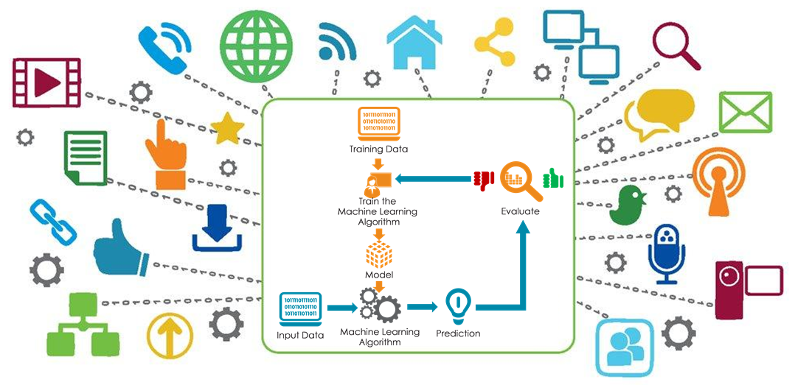
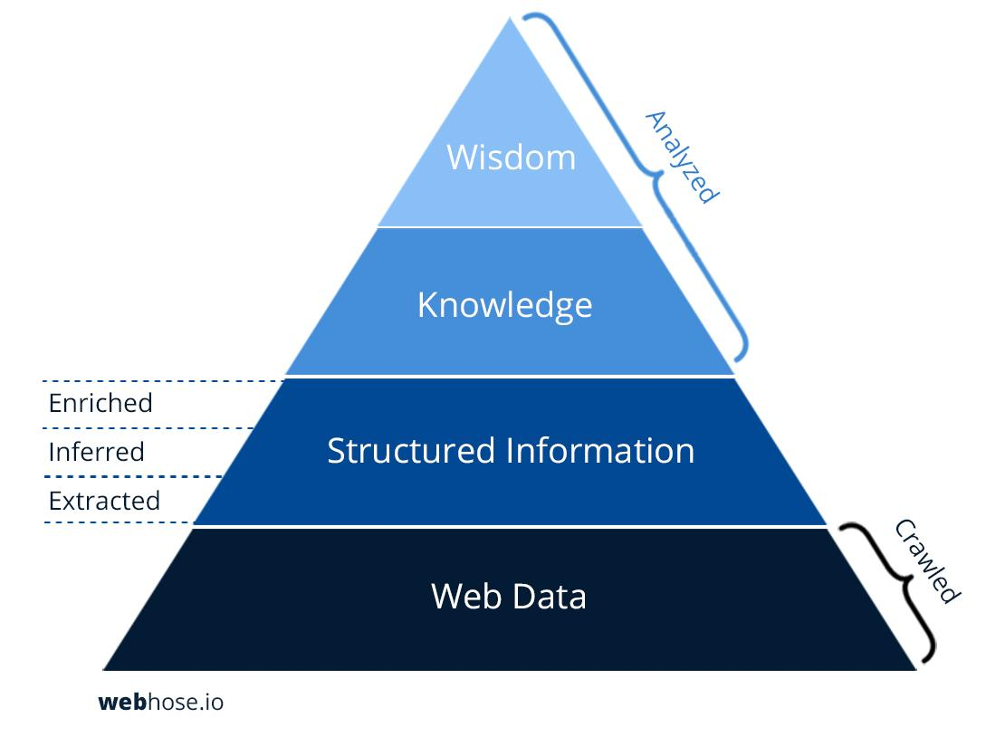
The web as a data source
The Internet is a huge store of the world's information - be it text, media or data in any other format. Every web page displays data in one form or another
Often most of this data is not easily accessible at scale (it is unstructured, scatter…)
The question is whether or not the author of the data makes it easy for us to grab it
If it does, they will offer an API or language specific wrapper libraries to access the data
If not, you need to do Web scrapping
Basically, automatically generating HTTP requests
Parse the HTTP response and try to capture patterns (Regex?)
Store the capture patterns (data) into a machine learning algorithm amenable form
Then, machine learning algorithms can leverage the obtained data into useful knowledge/information
Data is all over the web, for anyone with the right skill to take advantage of it

Slide 4
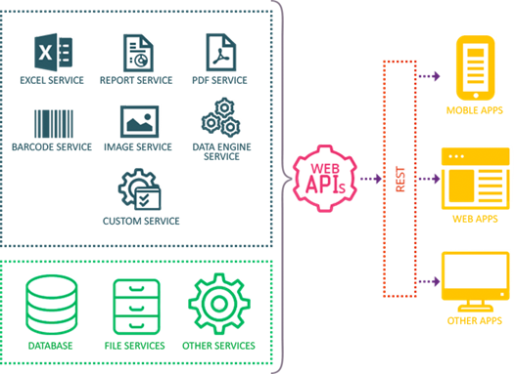
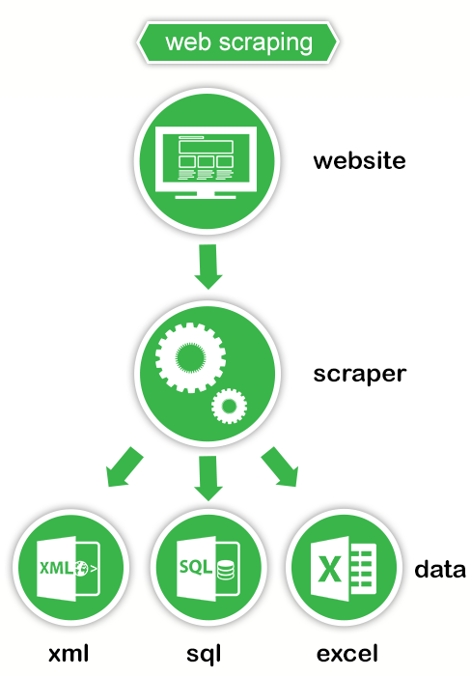
Web scraping vs API
2 ways of capturing data from the Internet
(application programming interface)
Web Scraping/HTML Parsing
The data source eases our access to the data through a well documented protocol
Makes the call for us (the author is “allowing us” to access the data and has created a logical interface to serve the data to us)
Use HTTP requests and parse returned HTTP responses (HTML, XML,etc) to scrape relevant information

Slide 5
API AND API wRAPPER
API vs. API wrapper
Use HTTP requests to obtain usually well structured data in return. May still be a bit confusing how to call the right end point (URL)
Wraps the API functionality within a library for a specific programming language (i.e. gives us programming language specific functions to access the data)
http://www.pythonforbeginners.com/api/list-of-python-apis
https://github.com/realpython/list-of-python-api-wrappers

Slide 6
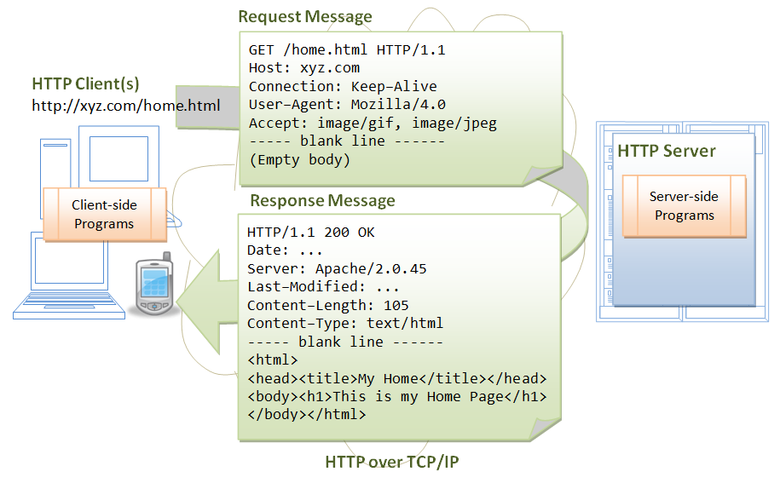
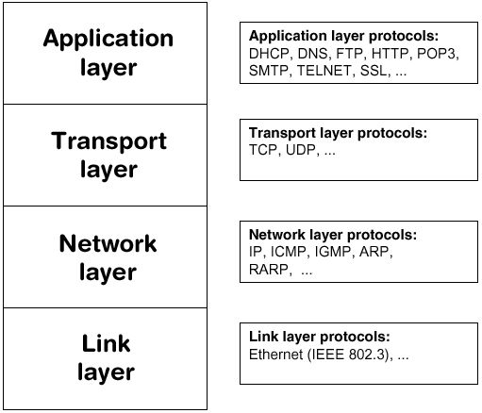
Some preliminaries: HTTP refresher
In order to exploit the functionality of web APIs, you need to be familiar with the HTTP protocol
Hypertext Transfer Protocol (HTTP) is an application-layer protocol for transmitting hypermedia documents, such as HTML, or data (i.e. JSON, XML,…)
HTTP follows a classical client-server model, with a client opening a connection to make a request, then waiting until it receives a response
Technology behind how web browsers operate
Notes:
To present a Web page, the browser sends an original request to fetch the HTML document from the page.
It then parses this file, fetching additional requests corresponding to execution scripts, layout information (CSS) to display, and sub-resources contained within the page (usually images and videos).
The Web browser then mixes these resources to present to the user a complete document, the Web page.
Scripts executed by the browser can fetch more resources in later phases and the browser updates the Web page accordingly.

Slide 7
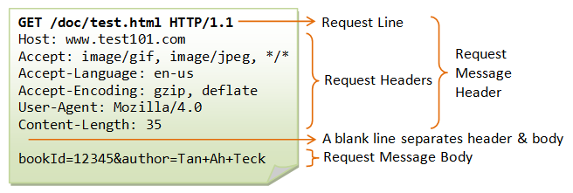
HTTP Client Request
Once the TCP connection is established, the user-agent can send the request
A client request consists of text directives (not in HTTP v2), separated by CRLF (carriage return, followed by line feed) divided into 3 blocks:
1:
An HTTP method, usually a verb like GET, POST or a noun like OPTIONS or HEAD that defines the operation the client is requesting
The path of the resource to fetch; the URL of the resource stripped from elements that are obvious from the context, for example without the protocol (http://), the domain (here test101.com), or the TCP port (here 80).
The version of the HTTP protocol.
2:
Optional headers that convey additional information for the servers. These HTTP headers form a block which ends with an empty line.
3:
An optional body (payload), for some methods like POST, similar to those in responses, which contain the resource sent.
Method
Path
Version of the protocol
POST

Slide 8
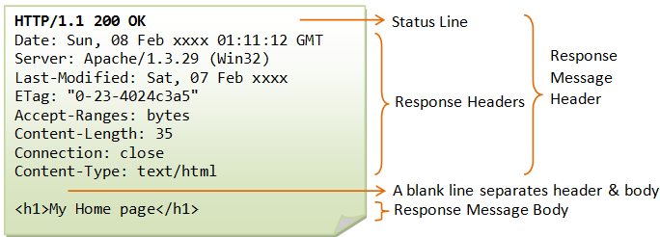
HTTP Response Syntax
The HTTP response contains:
1
A status code, indicating if the request has been successful, or not, and why
A status message, a non-authoritative short description of the status code
2
HTTP headers, like those for requests
3
Optionally, but more common for responses, a body containing the fetched resource
Version of the protocol
Status Code
Status message

Slide 9
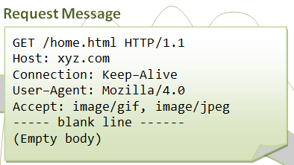
HTTP Methods
HTTP defines a set of request methods to indicate the desired action to be performed for a given resource. Although they can also be nouns, these request methods are sometimes referred as HTTP verbs.
GET: requests a representation of the specified resource.
Requests using GET should only retrieve data.
POST: used to submit an entity to the specified resource, often causing a change in state or side effects on the server
PUT: replaces all current representations of the target resource with the request payload.
DELETE: the client wants to delete a resource
HEAD: like GET but server returns only headers
OPTIONS: the client asks the server about its supported capabilities
TRACE: the client knows the route of its requests towards the server
PATCH: used to apply partial modifications to a resource.
CONNECT: establishes a tunnel to the server identified by the target resource.
Extension methods: not defined in the HTTP specification
These http methods don't map to those actions automatically. They have to be interpreted by the web service
Not all web services are sensitive to all http methods or verbs

Slide 10
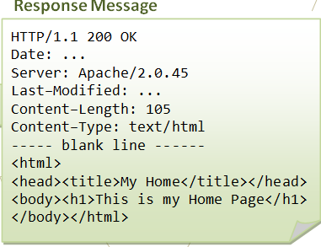
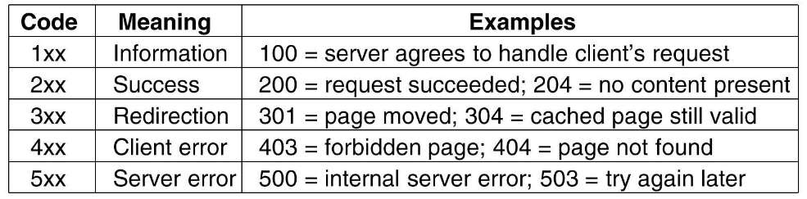
HTTP status codes
HTTP response status codes indicate whether a specific HTTP request has been successfully completed.
Responses are grouped in five classes
Complete list of HTTP status codes

Slide 11
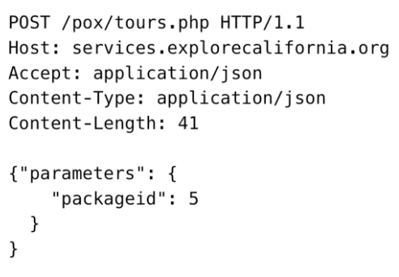
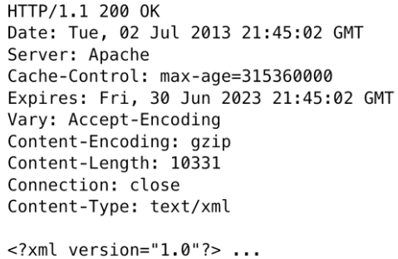
HTTP Headers
HTTP headers allow the client and the server to pass additional information to each other on each request or response.
A request/response header consists of its case-insensitive name followed by a colon ':', then by its value (without line breaks).
Leading white space before the value is ignored.
Custom proprietary headers can be added using the 'X-' prefix, but this convention was deprecated in June 2012, because of the inconveniences it caused when non-standard fields became standard
HTTP response
HTTP request

Slide 12
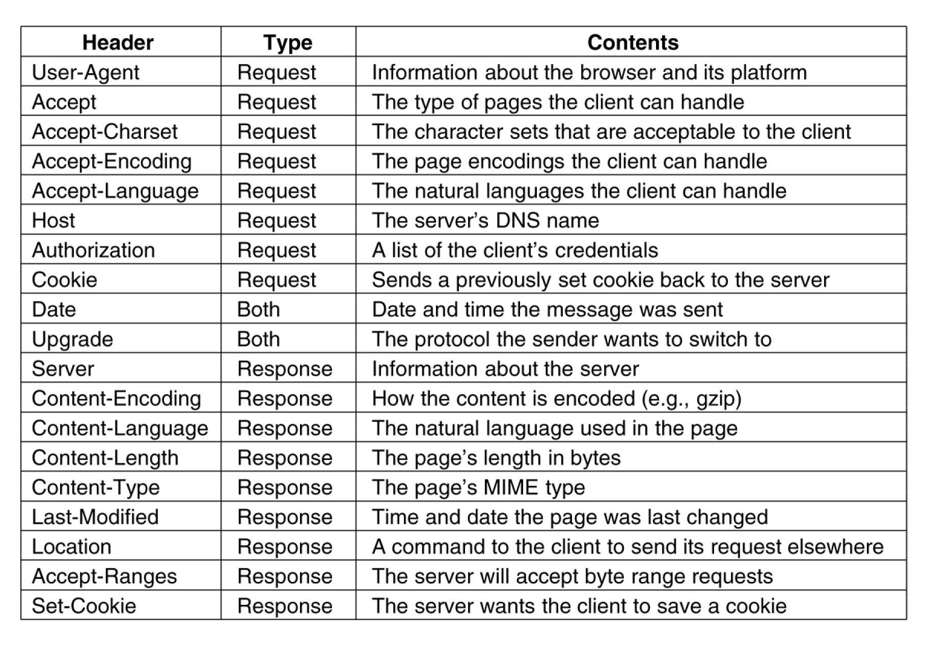
HTTP Headers examples

Slide 13
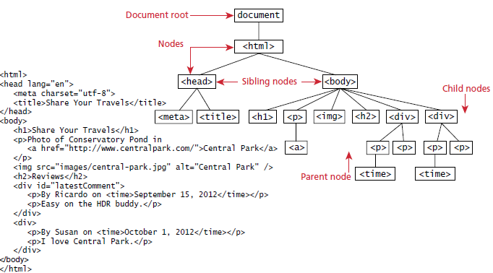
Common HTTP response body: an HTML document represented in the browser as the DOM (not important for today’s class but critical for next class on web scraping)
screen
location
history
navigator

Slide 14
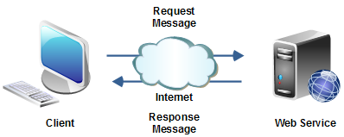
Web Service aka Web API
The term API stands for Application Programming Interface. The term can be used to describe the features of a library, or how to interact with it.
Your favorite software library may have "API Documentation" which documents which functions are available, how you call them, which arguments are required, etc.
APIs can be web-based
For example, Twitter has an API that allows you to request tweets data in a format that makes it easy to import into your own application.
Web APIs allow your web page to consume computation performed on another machine or to fetch data stored in another machine.

Slide 15
Simplest Web Service
The very simplest web service consumption is just flicking an HTTP GET request in the shape of a URL with a query string
The returned data is usually in the form of JSON or XML data
The returned data needs to be appropriately processed (parsed) by your application
Many of such web services require an authorisation key, which is included in the query string
Keys might or might not be free, and usually only allow a limited number of searches per day

Slide 16
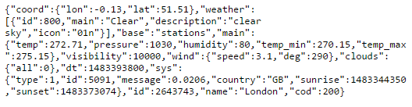
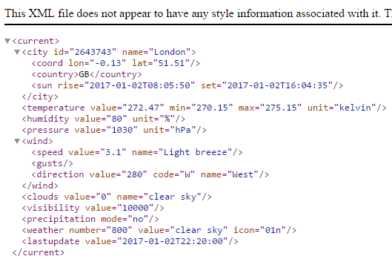
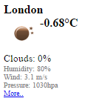
Exemplary responses from a weather API
http://api.openweathermap.org/data/2.5/weather?q=London,uk&appid=f6b6fecf2c4292d8d19d201e57667588
http://api.openweathermap.org/data/2.5/weather?q=London,uk&appid=f6b6fecf2c4292d8d19d201e57667588&mode=xml
http://api.openweathermap.org/data/2.5/weather?q=London,uk&appid=f6b6fecf2c4292d8d19d201e57667588&mode=html

Slide 17
Geolocation API
https://maps.googleapis.com/maps/api/geocode/json?sensor=false&address=london
{
"results" : [
{
"address_components" : [
{
"long_name" : "London",
"short_name" : "London",
"types" : [ "locality", "political" ]
},
{
"long_name" : "London",
"short_name" : "London",
"types" : [ "postal_town" ]
},
{
"long_name" : "Greater London",
"short_name" : "Greater London",
"types" : [ "administrative_area_level_2", "political" ]
},
{
"long_name" : "England",
"short_name" : "England",
"types" : [ "administrative_area_level_1", "political" ]
},
{
"long_name" : "United Kingdom",
"short_name" : "GB",
"types" : [ "country", "political" ]
}
],
"formatted_address" : "London, UK",
"geometry" : {
"bounds" : {
"northeast" : {
"lat" : 51.6723432,
"lng" : 0.148271
},
"southwest" : {
"lat" : 51.38494009999999,
"lng" : -0.3514683
}
},
"location" : {
"lat" : 51.5073509,
"lng" : -0.1277583
},
"location_type" : "APPROXIMATE",
"viewport" : {
"northeast" : {
"lat" : 51.6723432,
"lng" : 0.148271
},
"southwest" : {
"lat" : 51.38494009999999,
"lng" : -0.3514683
}
}
},
"place_id" : "ChIJdd4hrwug2EcRmSrV3Vo6llI",
"types" : [ "locality", "political" ]
}
],
"status" : "OK"
}
Continuation from left

Slide 18
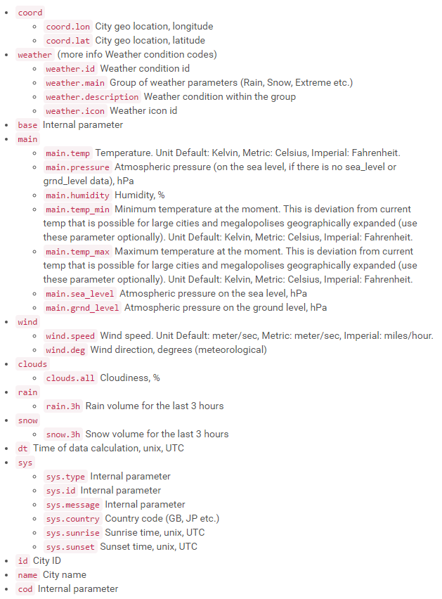
The API documentation helps us understand the information retrieved
http://api.openweathermap.org/data/2.5/weather?q=London,uk&appid=f6b6fecf2c4292d8d19d201e57667588
{"coord":{"lon":-0.13,"lat":51.51},
"weather":[{"id":800,"main":"Clear","description":"clear sky","icon":"01n"}],
"base":"stations",
"main":{"temp":272.14,"pressure":1030,"humidity":93,"temp_min":271.15,"temp_max":274.15},
"visibility":10000,
"wind":{"speed":2.6,"deg":230},
"clouds":{"all":0},
"dt":1483399200,
"sys":{"type":1,"id":5091,"message":0.0105,"country":"GB","sunrise":1483344349,"sunset":1483373077},
"id":2643743,
"name":"London",
"cod":200}
http://api.openweathermap.org

Slide 19
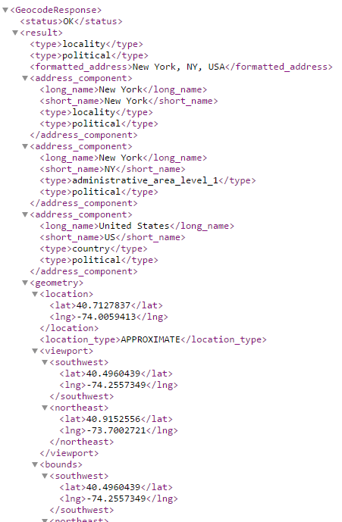
Message Formats for web services: XML
http://maps.googleapis.com/maps/api/geocode/xml?address=New%20York

Slide 20
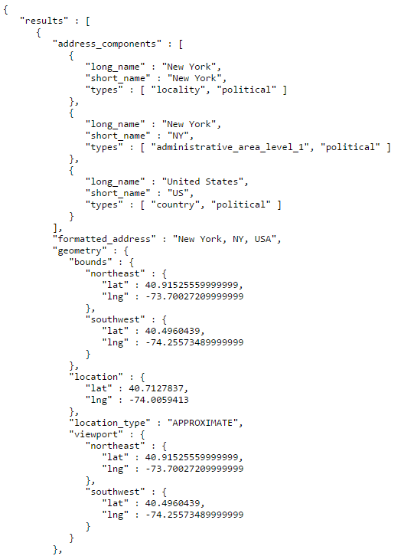
Message Formats for web services: JSON
http://maps.googleapis.com/maps/api/geocode/json?address=New%20York

Slide 21
Other Message Formats for web services
Action Message Format or AMF
binary format that was originally created for Macromedia's Flash
HTML
it isn't particularly well suited for structure data but is sometimes used for it anyway
Comma or tab separated files (csv…)
Arbitrary text formats that require custom parsers
Binary formats including
Spreadsheets
Archive data bases
Image files
Video
Audio

Slide 22
Web Service Standards: REST
REST is a set of technologies that are routinely used to create modern web services
Its main benefit is that it is simpler and more lightweight than SOAP or proprietary web-service mechanisms
In the mid 2000s, Software engineers observed a similarity between the CRUD (Create, Read, Update, Delete) functionality that web services often provide and basic HTTP operations (GET, POST, PUT, DELETE)
They also observed that much of the information that is required for a typical web-service call could be compacted on a resource URL
For example, http://api.mysite.com/customer/john is a resource URL that allows us to identify the target server (api.mysite.com), the fact that I'm trying to perform operations related to customers (table) and more specifically something about someone named john (row—primary key).
When combined with other web concepts, such as secure authentication, being stateless, caching, XML or JSON as payload, and so on, REST provides a powerful yet simple, familiar, and effortlessly cross-platform way to provide and consume web services
It's no wonder that REST took the software industry by storm

Slide 23
REST overview
REST (representational State transfer)
REST requirements are light weight
use simple HTTP request/response messaging
REST is an architecture, not a specific web service messaging format, and it's wrapped around the concept of HTTP methods/areverbs
Rest defines a set of architectural principles by which you can design Web services
Use HTTP methods explicitly
Be stateless
Expose hierarchical directory structure-like URIs
Transfer data using JSON, XML or both
Strict following the previous principles will make your web service RESTful (i.e. platform/programming language/framework independent)

Slide 24
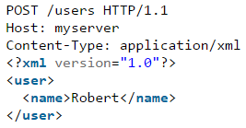
1. Use HTTP methods explicitly
REST explicitly uses HTTP methods in a way that follows the protocol specifications
This basic REST design principle establishes a one-to-one mapping between create, read, update, and delete (CRUD) operations and HTTP methods
To create a resource on the server, use POST
To retrieve a resource from the server, use GET
To update or change the state of a resource, use PUT
To remove a resource, use DELETE
RESTful (Good)
Not RESTful (Bad)

Slide 25
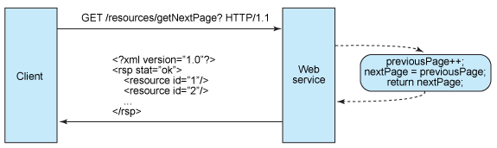
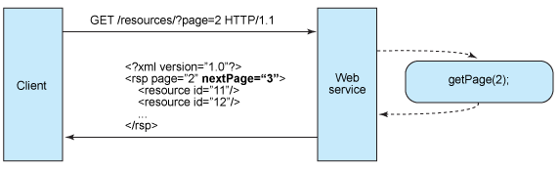
2. Be stateless
An application requests the next page in a multipage result set:
Stateful design Not RESTul (Bad)
Stateless design RESTul (Good)

Slide 26
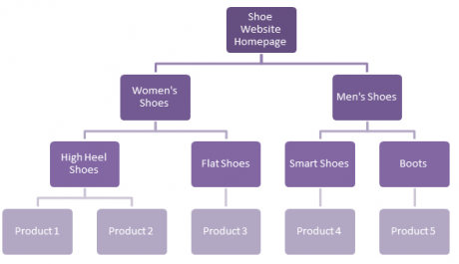
3. Expose directory structure-like URIs
The URIs determine how intuitive the REST Web service is going to be
A URI should be a self-documenting interface that requires little, if any, explanation or reference for a developer to understand what it points to and to derive related resources.
One way to achieve this level of usability is to define directory structure-like URIs.
This type of URI is hierarchical, rooted at a single path, and branching from it are subpaths that expose the service's main areas.
www.ashoewebsite.com
www.ashoewebsite.com/womens-shoes
www.ashoewebsite.com/womens-shoes/high-heels
www.ashoewebsite.com/womens-shoes/high-heels/product-1
www.ashoewebsite.com/mens-shoes
www.ashoewebsite.com/mens-shoes/boots
www.ashoewebsite.com/mens-shoes/boots/product-5
Uninformative, unstructured URI -> Not RESTul
http://www.mybookstore.com/XSD34SSFGGHSXF4
Informative, structured URI -> RESTul
http://www.mybookstore.com/users/userName/orders/1

Slide 27
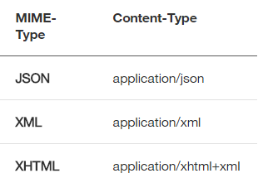
4. Transfer data using JSON, XML or both
Give client applications the ability to request a specific content type that's best suited for them
Construct your service so that it makes use of the built-in HTTP Accept header, where the value of the header is a MIME type.
This allows the service to be used by a variety of clients written in different languages running on different platforms and devices.
Using MIME types and the HTTP Accept header is a mechanism known as content negotiation, which lets clients choose which data format is right for them and minimizes data coupling between the service and the applications that use it
https://maps.googleapis.com/maps/api/geocode/json
Give the user of the API the freedom to choose data format -> RESTful
https://maps.googleapis.com/maps/api/geocode/xml

Slide 28
Using REST, requests looks like this:
Querying a phonebook application for the details of a given user:
GET /phonebook/UserDetails/12345 HTTP/1.1
Accept: application/xml
Creating a new user in the application:
POST /phonebook/UserDetails/12346 HTTP/1.1
Name=Peter
Phone=987 654 321
Editing information about an existing user in the application:
PUT /phonebook/UserDetails/12346 HTTP/1.1
Name=Peter
Phone=(01) 987 654 321
Deleting information about an existing user in the application:
DELETE /phonebook/UserDetails/12346 HTTP/1.1

Slide 29
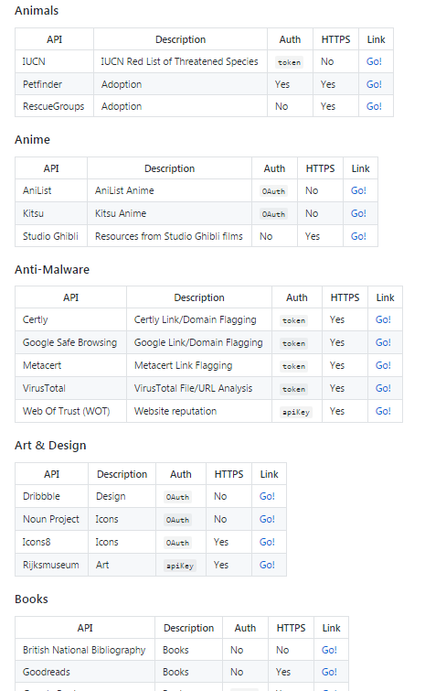
https://github.com/toddmotto/public-apis and
https://apigee.com/providers provide a large set of useful APIs
Examples of API’s:
Amazon (price data)
Twitter (tweets)
Facebook (social network)
New York Times
Wikipedia
National governments
US
NZ

Slide 30
References
https://www.ntu.edu.sg/home/ehchua/programming/webprogramming/http_basics.html

